Slide 1

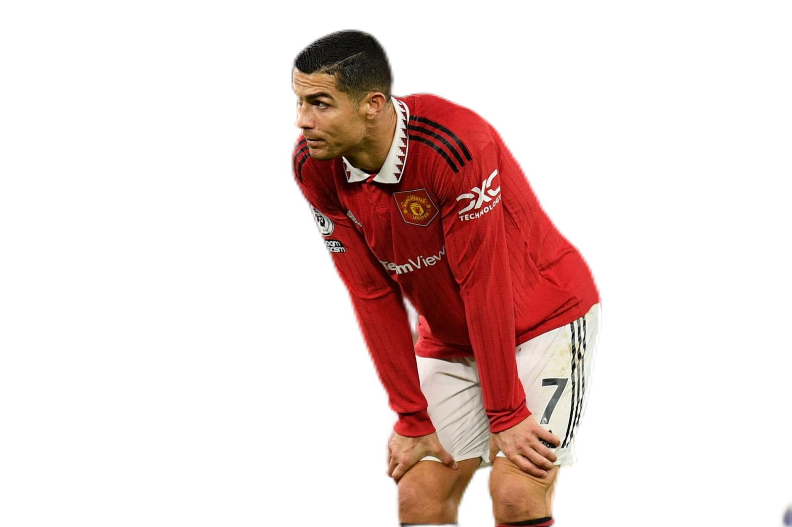
DATA ANALYSIS
OF
SOCCER PLAYER VALUE
Introduction of our APP
presenters: Zhiqi Zhu
Shiwen Zhang

Slide 2

01
Dataset

Slide 3

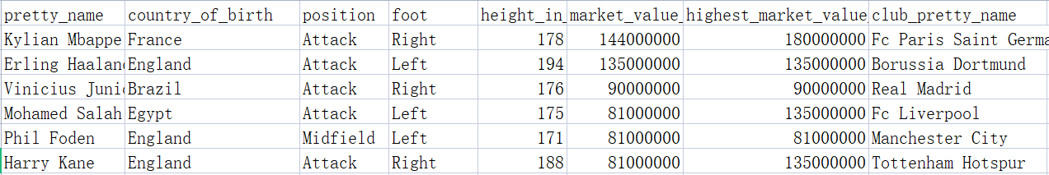
OUR dataset
source of our data:
https://www.kaggle.com/datasets/davidcariboo/player-scores?select=players.csv
example of our dataset:

Slide 4

02
questions & Analysis

Slide 5
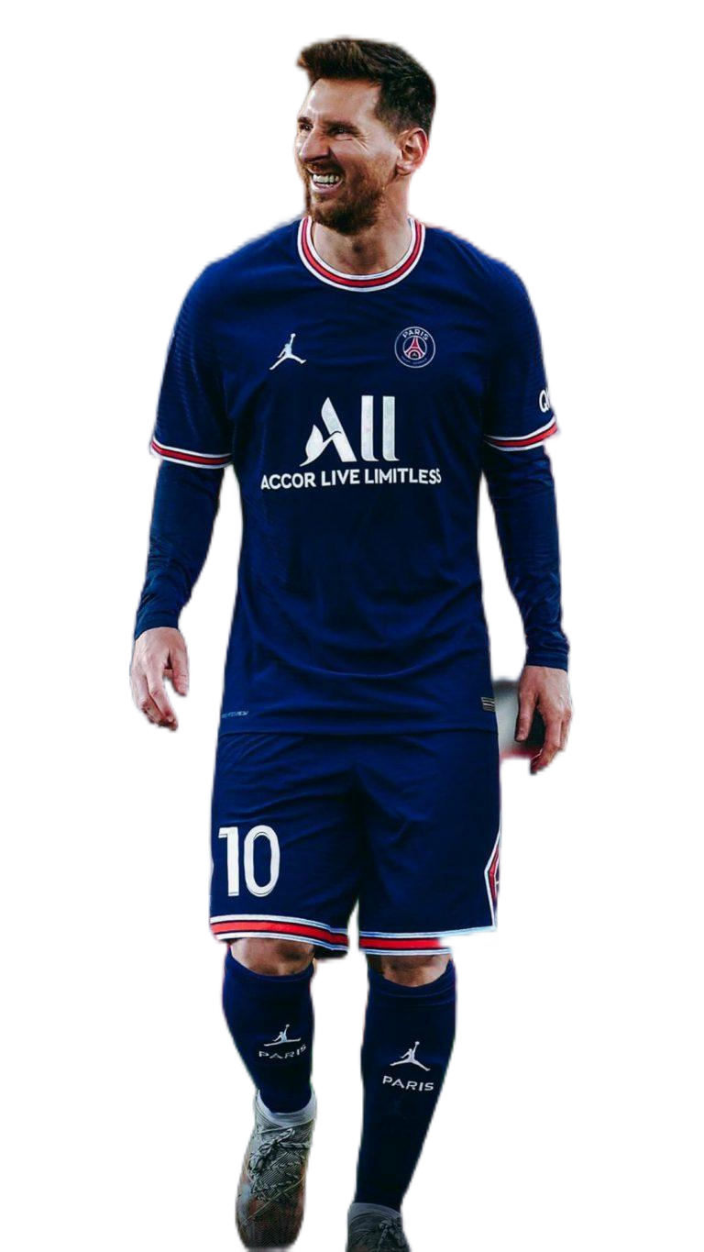
Q1: Are there any relations between the positions of the player and thier values?
Attack
Midfield
average: € 32.7million(Highest)
average: € 30.4million
Defender
Goalkeeper
average: € 28.1million
average: € 27.3million(Lowest)

Slide 6
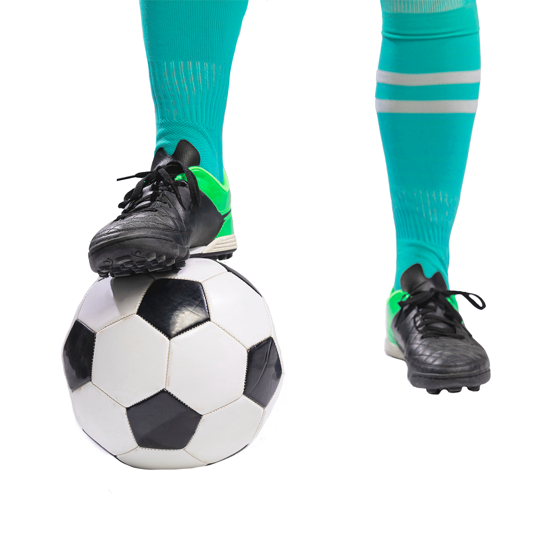
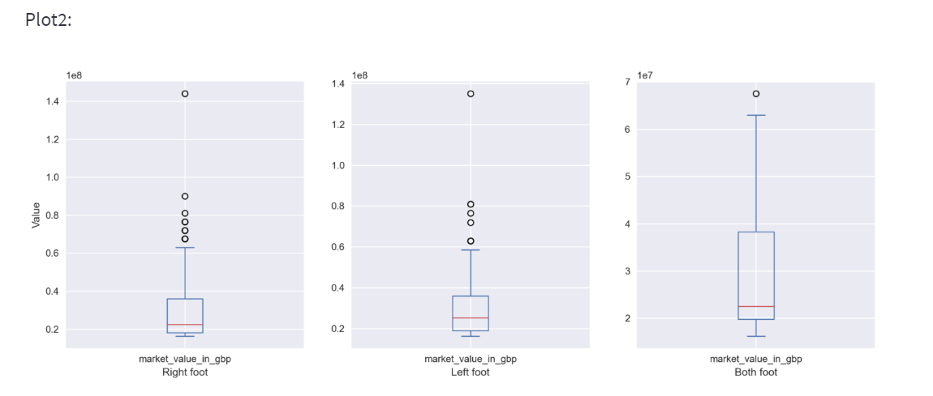
Question 2: If the preferred foot of soccer players have something to do with thier values?
left 26.2%
right 69.8%
both 4%
(In dataset)

Slide 7

03
Introduction of APP

Slide 8
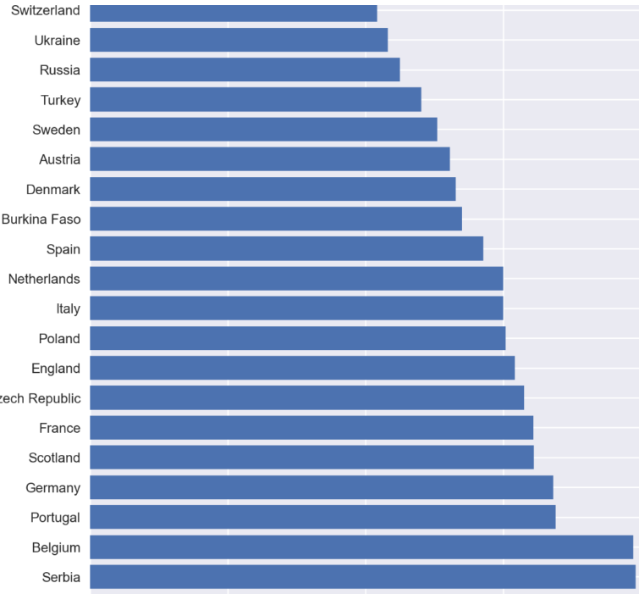
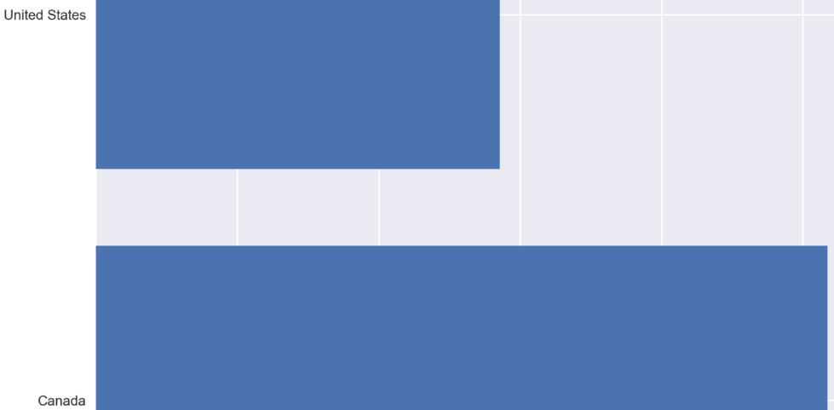
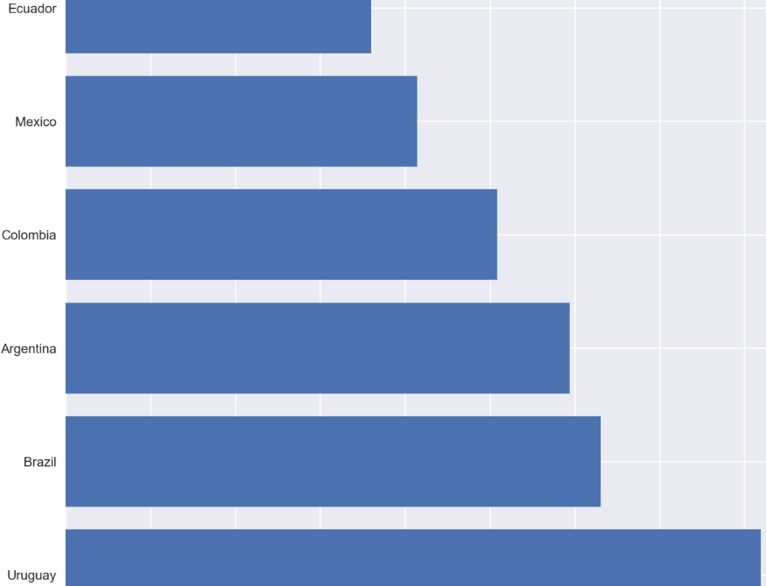
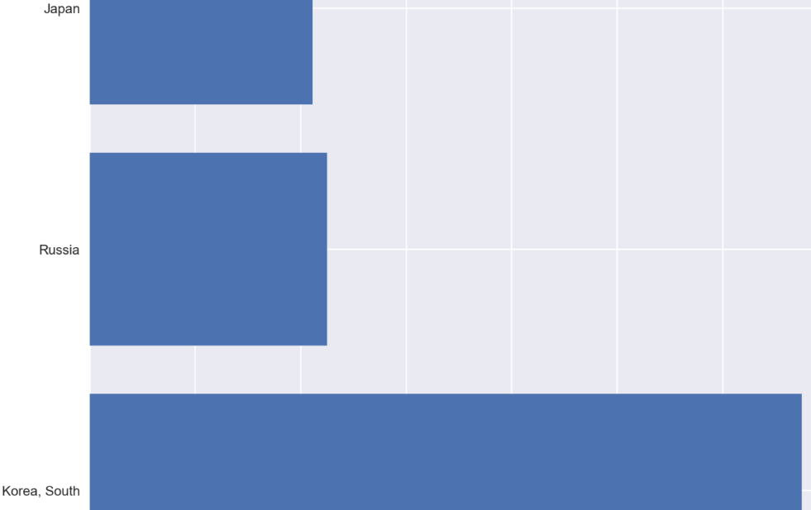
Nationality filter
NORYH AMERICA
EUROPE
LATIN AMERICA
ASIA

Slide 9
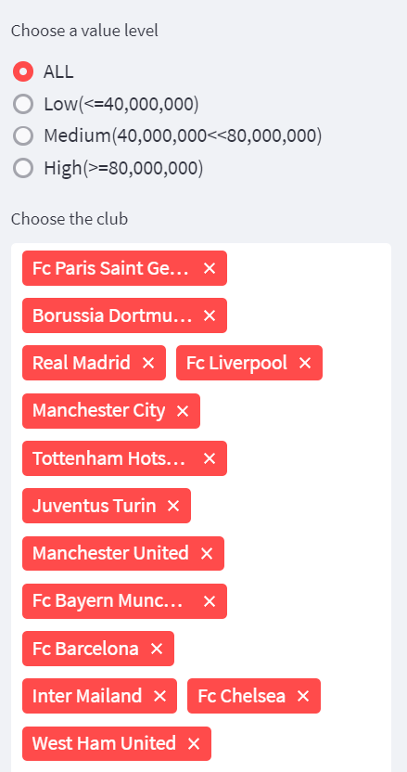
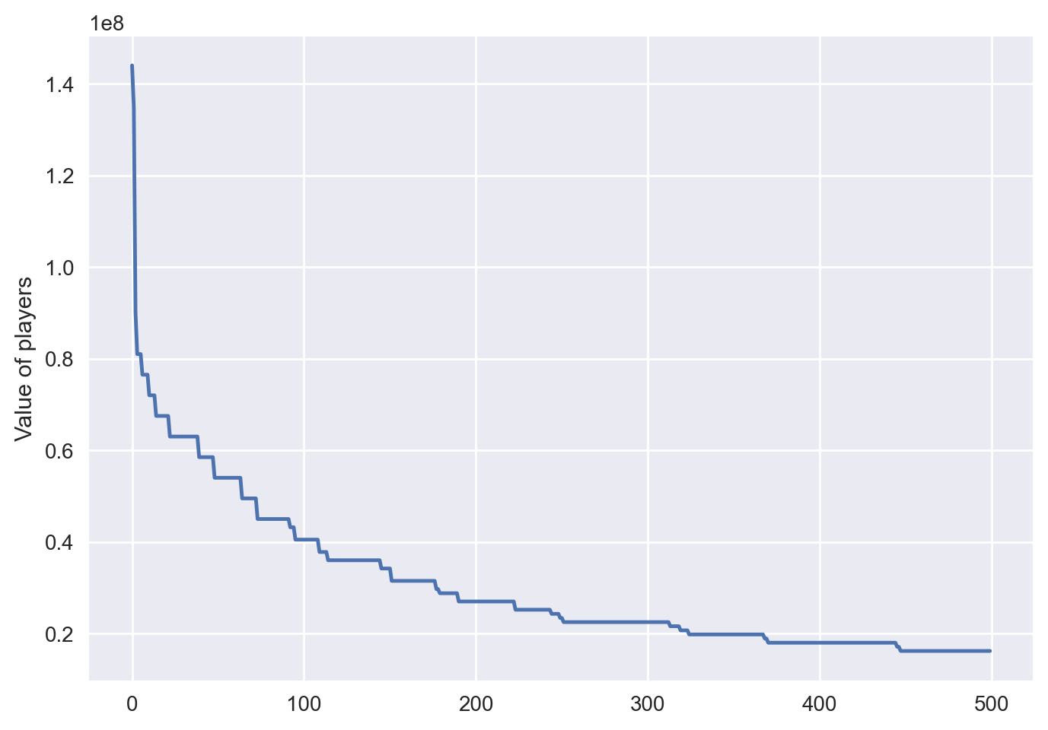
Others about our APP
club filter
Choose tag of club to check the player value of the club
line chart of overall price trend
value level filter
Choose value level for the player you check

Slide 10


THANK YOU!

